Slide 1
Chapter 1
Introduction to web development

Slide 2
Objectives
Applied
Load a web page from the Internet or an intranet into a web browser.
View the source code for a web page in a web browser.

Slide 3
Objectives (cont.)
Knowledge
Describe the components of a web application.
Distinguish between the Internet and an intranet.
Describe HTTP requests and responses.
Distinguish between the way a web server processes static web pages and dynamic web pages.
Describe the use of JavaScript.
Distinguish between HTML and CSS.
Explain how you deploy a website on the Internet.
Describe the components of an HTTP URL.
Describe these four web development issues: Responsive Web Design, cross-browser compatibility, web accessibility, and search engine optimization (SEO).

Slide 4
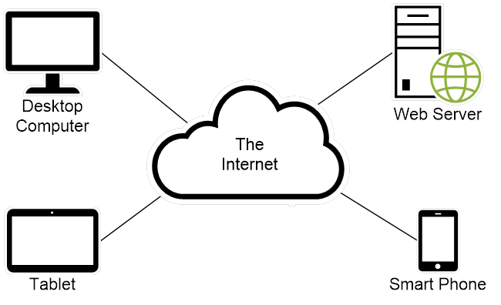
The components of a web application

Slide 5
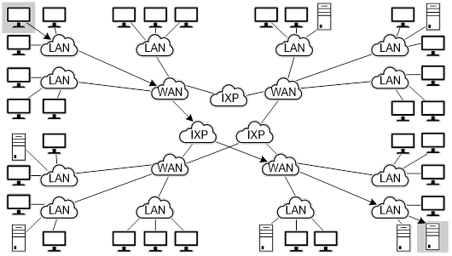
The architecture of the Internet

Slide 6
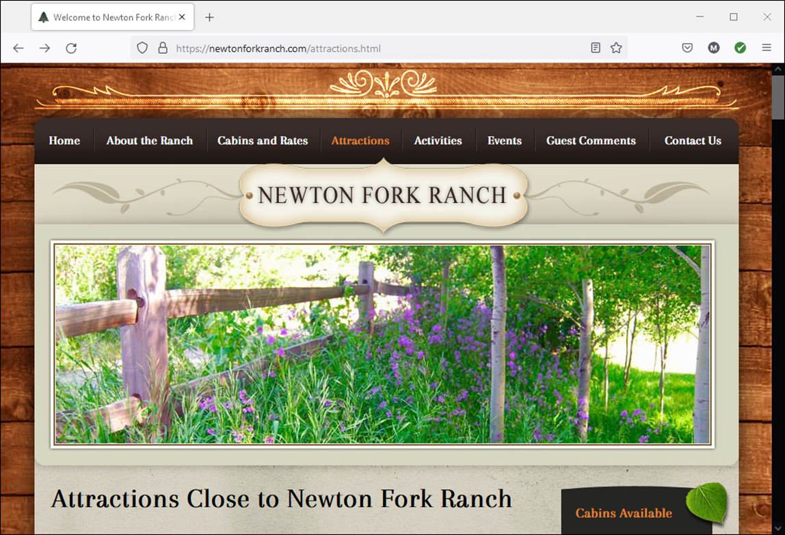
A static web page

Slide 7
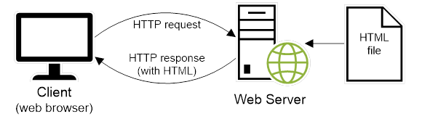
How a web server processes a static web page

Slide 8
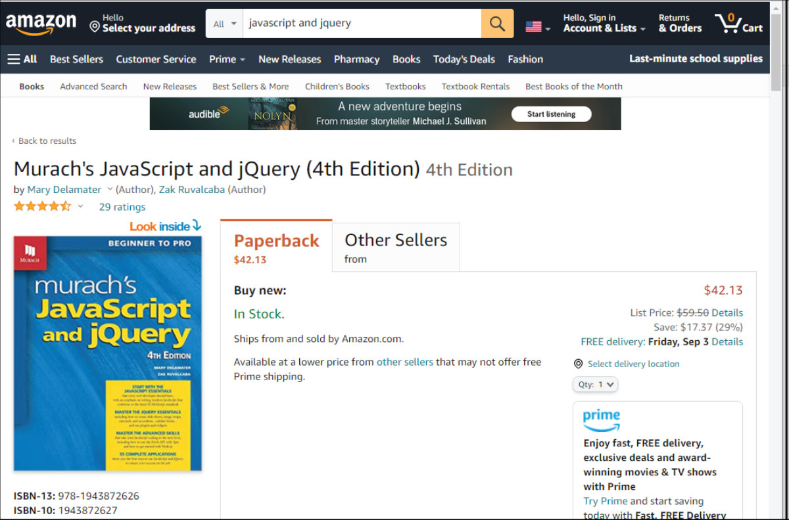
A dynamic web page at amazon.com

Slide 9
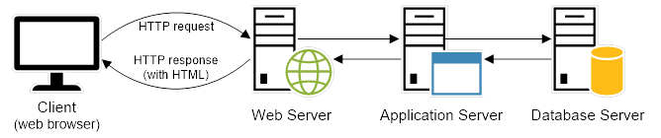
How a web server processes a dynamic web page

Slide 10
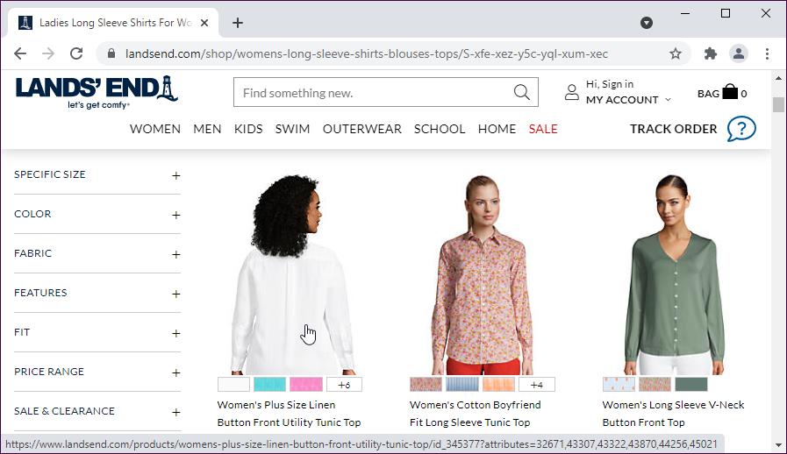
A web page with image swaps and rollovers

Slide 11
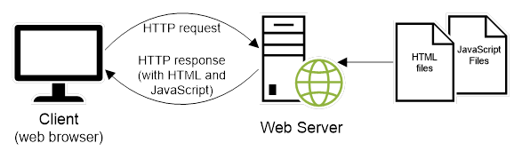
How JavaScript fits into this architecture

Slide 12
Some common uses of JavaScript
Data validation
Image swaps and rollovers
Carousels and accordions
Slide shows

Slide 13
The code for an HTML file
<!doctype html>
<html lang="en">
<head>
<meta charset="utf-8">
<title>JavaScript and jQuery book</title>
</head>
<body>
<h1>JavaScript and jQuery (4th Edition)</h1>
<img src="javascript_jquery.jpg" alt="JavaScript and jQuery Book">
<p>Today, ... does best.</p>
<p>Now, ... <a href="">read more...</a></p>
</body>
</html>

Slide 14
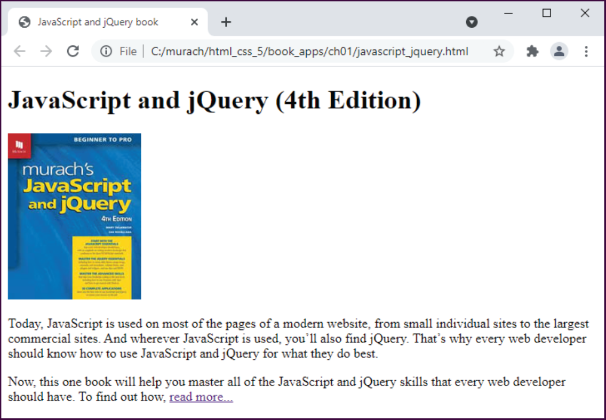
The HTML displayed in a web browser

Slide 15
The link element for a CSS file
<link rel="stylesheet" href="book.css">

Slide 16
The code for the CSS file named book.css
body {
font-family: Arial, Helvetica, sans-serif;
font-size: 100%;
width: 550px;
margin: 0 auto;
padding: 1em;
border: 1px solid navy;
}
h1 {
margin: 0;
padding: .25em;
font-size: 200%;
color: navy;
}
img {
float: left;
margin: 0 1em 1 em 1em; }
p {
margin: 0;
padding-bottom: .5em; }

Slide 17
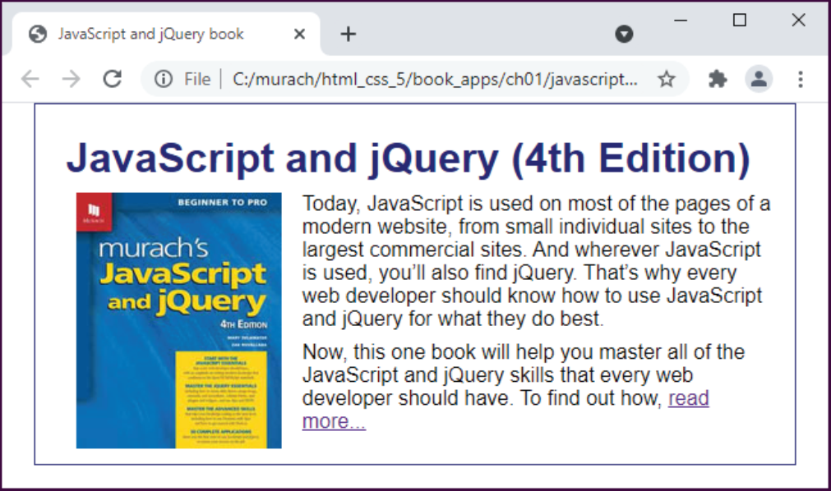
The web page displayed in a web browser

Slide 18
Two websites to become familiar with
World Wide Web Consortium (W3C)
Web Hypertext Application Technology Working Group (WHATWG)

Slide 19
Four free text editors
VS Code
Notepad++
TextMate
Codepen

Slide 20
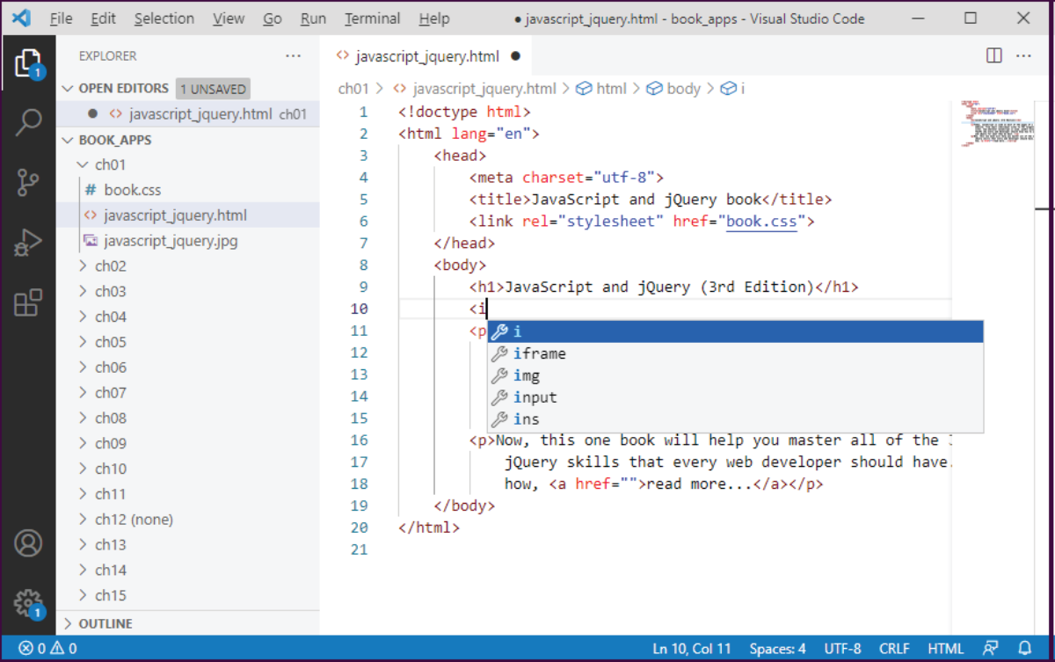
VS Code and its auto-completion feature

Slide 21
Two of the IDEs for web development
Adobe Dreamweaver
AWS Cloud9

Slide 22
Some free FTP clients
FileZilla
FireFTP
Classic FTP

Slide 23
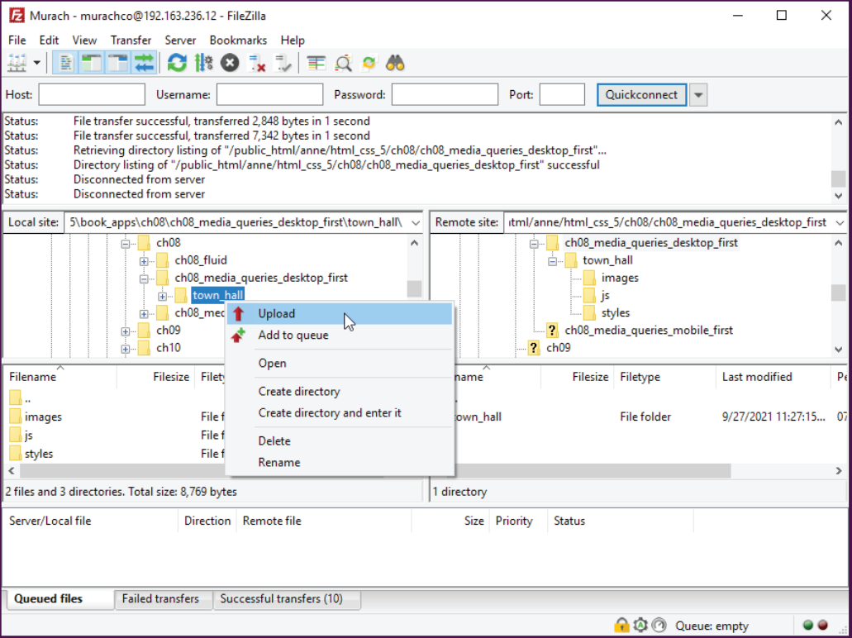
FileZilla as it’s used to upload files

Slide 24
The components of an HTTP URL
protocol://domain-name/path/filename
A URL with an omitted filename
http://www.murach.com/courseware-for-trainers /what-our-courseware-includes
What happens if you omit parts of a URL
If you omit the protocol, the default of http:// will be used.
If you omit the filename, the default document name for the web server will be used.

Slide 25
How to access a web page on the Internet
Enter the URL of a web page into the browser’s address bar.
How to access a web page on your own server or computer
Use the features of your text editor or IDE.
Find the file in File Explorer or Finder. Then, double-click on it to open it in your default browser. Or, right-click on it and use the Open With command to select the browser.

Slide 26
Naming recommendations for folders and files
Create names for folders and files that consist of lowercase letters, numbers, underscores or hyphens, and the period.
Use filenames that clearly indicate what a page contains. This is good for search engine optimization.

Slide 27
How to view the HTML for a web page
Right-click the page and select View Source or View Page Source from the popup menu.
In Chrome, the source code is displayed in a new browser tab or a separate window.

Slide 28
How to view the CSS code in an external CSS file
Click on the link that refers to the CSS file.
How to view the CSS if it’s in the HTML file
Look in the head element of the file.

Slide 29
Four issues for web developers
Responsive web design
Cross-browser compatibility
Web accessibility
Search engine optimization (SEO)

Slide 30
The issue of Responsive Web Design
Responsive Web Design means that a website should adapt to the screen size of the device that’s accessing it, whether it’s a desktop computer, a tablet, or a mobile phone.
Typically, the overall look-and-feel of the website will be consistent from one screen size to the next.

Slide 31


The Lands’ End home page in desktop and mobile

Slide 32
Four of the statistics that prove the need for Responsive Web Design
In a global survey of 87,000 users, 95% used mobile phones to access the Internet, 93% used desktops, and 73% used tablets.
57% of all web traffic comes from mobile devices.
50% of all web shoppers in the United States buy from mobile devices.
40% of the mobile users will go to a different site if the first one isn’t mobile friendly.

Slide 33
Guidelines for cross-browser compatibility
Code with the latest versions of HTML and CSS.
Test your web pages on all of the major browser as well as table and mobile phones.

Slide 34
Web browsers
Chrome
Edge
Safari
Firefox
Opera

Slide 35
Web accessibility
Accessibility laws that you should be aware of
The Americans with Disabilities Act (ADA).
Sections 504 and 508 of the federal Rehabilitation Act.
Section 255 of the Telecommunications Act of 1996.
Types of disabilities
Visual
Hearing
Motor
Cognitive

Slide 36
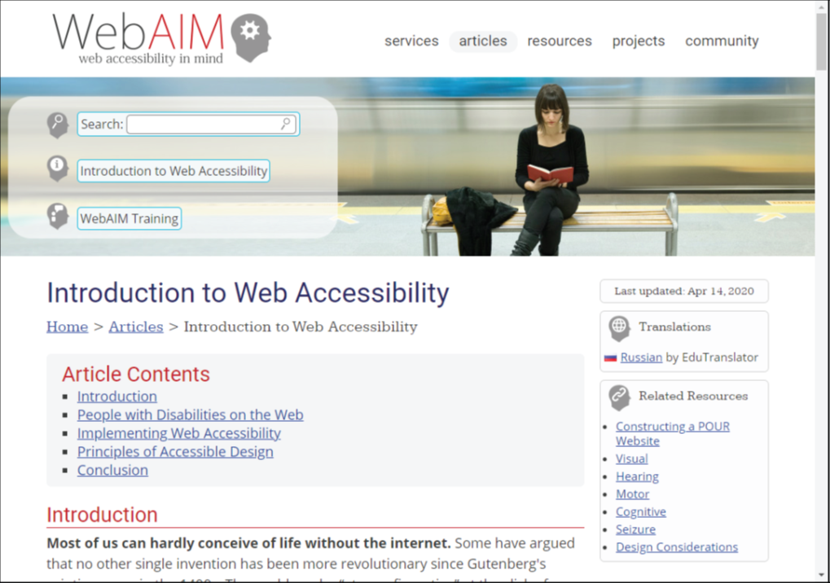
The WebAIM website

Slide 37
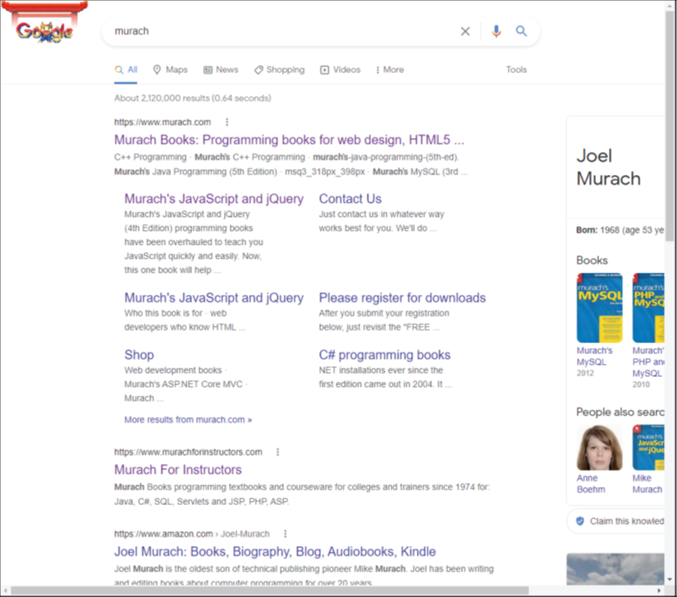
Search engine optimization
The results of a Google search for “murach”

Slide 38
The most popular search engines
Google
Bing

